Slide 1
Predicting Innovative Drugs through Adverse Event Reports
Jonathan M. Bryan General Assembly Data Science 4

Slide 2
Measuring Drug “Innovation” is Difficult
No standard definition of innovation
Raw approval rates?
Novel metabolic mechanisms?
Economic evaluations?
Quality adjusted life years (QALYs)?
Limited data availability
Regulatory and proprietary barriers
Notes:
So to begin, I drew my project question from the work I do related to the science and policy that drives biomedical innovation and evidence generation
A key question within this space is what qualifies as innovation for pharmaceuticals and biologic medial products?
Needless to say the domain suffers from poor proxy metrics that only hint at the heart of the issue.
Many researchers tend to default to looking at approval rates. Higher rates of approval for new drugs and biologics mean the innovation engine is roaring.
But just because a drug is approved does not mean it constitutes a significant step forward in therapeutic benefit
Other more explanatory metrics have been proposed but they all suffer from limited data.

Slide 3
Lanthier et al.
Examined 645 new molecular entities (NME, drugs and biologics) from 1987-2011
Categorized drugs into three distinct classes:
“First-in-class”
“Advanced-in-class”
“Addition-to-class”
Found NME approvals were largely driven by addition-to-class approvals, and a higher proportion of first-in-class drug approvals over the most recent decade
Notes:
To work my way into this issue I started with a seminal paper on drug innovation, authored by a few folks at FDA
This paper is instructive because it divides drugs into three different class:
First in class
Advanced in class: and
Addition to class

Slide 4
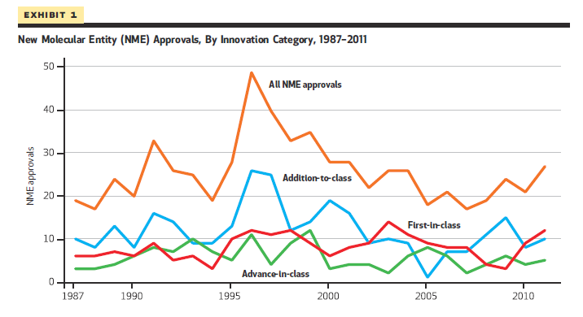
Notes:
FDA was happy with this report because they interpreted this graph as reporting that first-in-class approvals were trending up. First-in-class is representing by the red line

Slide 5
Difference Among Innovation Classes
“First-in-class”: Are pharmacologically innovative because each represents a new pathway for treating a disease.
“Advanced-in-class”: Drugs not first-in-class but received a priority review designation, which is reserved for medicines that potentially offer major advances in treatment. Priority review designation suggests a measurable degree of innovation in the clinical potential of a drug.
“Addition-to-class”: Function similarly to other drugs in their class and do not offer substantial advantages in safety or efficacy over existing products. Generally represent a lower degree of innovation because at the time of FDA review, they did not distinguish themselves in terms of potential clinical benefit.
Notes:
First-in-class drugs are pharmacologically innovative because each represents a new pathway for treating a disease.
Advance-in-class drugs were defined as drugs that were not first-in-class but received a priority review designation, which is reserved for medicines that potentially offer major advances in treatment. Priority review is granted only to marketing applications when the candidate therapy can differentiate itself from existing treatments in a clinically meaningful way.
Addition-to-class these drugs function similarly to other drugs in their class and do not offer substantial advantages in safety or efficacy over existing products.

Slide 6
Working Definition of “Innovation”
Innovation = F( Safety + Effectiveness )
Notes:
For this project attempted to develop my own conceptual framework for innovation by breaking down Lantheie’rs definition of innovation into different parts.
I did this by first recognizing that drugs are evaluated by the FDA for their safety and effectiveness

Slide 7
Working Definition of “Innovation”
Innovation = F( Safety + Effectiveness* )
*Assume that relative effectiveness is the same across all innovation classes for each therapeutic class
i.e., Eff_{Fir}(NSAID) = Eff_{Adv}(NSAID) = Eff_{Add}(NSAID) = Eff_{Fir}(Statin) = Eff_{Adv}(Statin) = Eff_{Add}(Statin)
Notes:
For this project I decided to work with adverse safety events and thus would be interacting with the saftey parameter of my innovation equation.

Slide 8
Working Definition of “Innovation”
Innovation = F( Safety + Effectiveness* )
*Assume that relative effectiveness is the same across all innovation classes for each therapeutic class
i.e., Eff_{Fir}(NSAID) = Eff_{Adv}(NSAID) = Eff_{Add}(NSAID) = Eff_{Fir}(Statin) = Eff_{Adv}(Statin) = Eff_{Add}(Statin)
Adverse Events (FAERS)
Notes:
I also made a key assumption that the therapeutic effectiveness of each drug was the same across their respective drug and innovation class.
As an example, all non-steroidal anti-inflammatory drugs (NSAIDs) would have the same effectiveness across each innovation class but not when compared to cholesterol lowering drugs such as statins

Slide 9

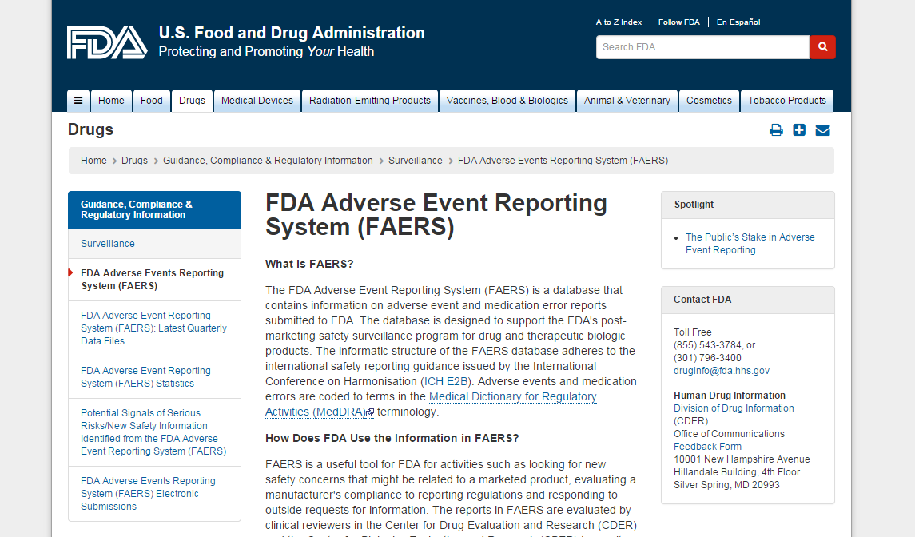
FDA Adverse Event Reporting System
Notes:
I drew my safety data from FDA’s Adverse Event Reporting System

Slide 10
FDA Adverse Event Reporting System
Supports the FDA's post-marketing safety surveillance program for drug and therapeutic biologic products.
+5 million records since 2004
FAERS is used to improve product safety and protect the public health, such as updating a product’s labeling information, restricting the use of the drug, communicating new safety information to the public, or, in rare cases, removing a product from the market.

Slide 11
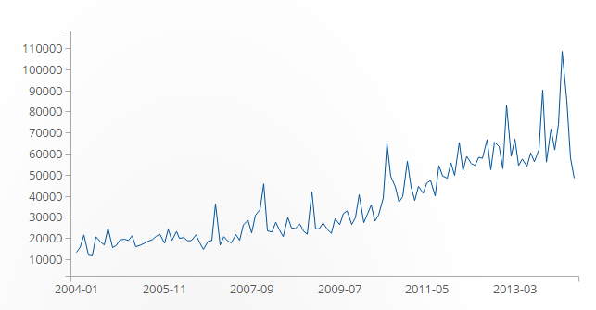
Adverse drug event reports since 2004
Notes:
Adverse event reporting has been climbing each year since 2004. The reasons are largely unknown given the size of the growth.

Slide 12
Issues with FAERS Data
Voluntary Reporting
Non-standard terminology
Uneven reporting across specific brands and drug classes
No denominator - limited utilization metrics
Unsure how many people used the drugs in relation to how many AE were reported

Slide 13
Hypothesis
Given the presumed innovative characteristics of “Advanced-in-class” drugs, so-called “Addition-to-class” drugs should have higher rates of adverse events
As a corollary, “First-in-class” drugs can be expected to have above average adverse event rates because of their novel characteristics

Slide 14
DRUGS_df
ISR (KEY) DRUG_SEQ ROLE_COD DRUGNAME* VAL_VBM ROUTE DOSE_VBM DECHAL RECHAL LOT_NUM EXP_DT NDA_NUM YEAR QTR
DRUGS_PS_df (5,823,558)
ISR (KEY) DRUG_SEQ ROLE_COD DRUGNAME* VAL_VBM ROUTE DOSE_VBM DECHAL RECHAL LOT_NUM EXP_DT NDA_NUM YEAR QTR
*To link the Master_df data with the DRUGS_df, OUTCOME_df, and DEMO_df data I searched for the ‘Trade_Name’ in the ‘DRUGNAME’ column in DRUG_PS_df and built a dictionary with each ‘Trade_Name’ as the key and the value as a list of the associated ‘ISR’ keys.
ONLY PRIMARY SUSPECT DRUGS
Lanthier_df (644)
Approval_Year Trade_Name* Active_Ing Lan_Drug_Class FDA_Drug_Class Innovation_Cat Top_25 Num_Adv_Event Num_Serious Num_Other Num_Life_Threat Num_Hosp Num_Congen_Anom Num_Disable Num_Deaths Num_Male Num_Female AE_Per_Year Adj_Num_AE Adj_Per_Year
OUTCOME_df (5,159,925)
ISR (KEY) OUTC_COD YEAR QTR
DEMO_df (5,791,481)
ISR (KEY) I_F_COD AGE AGE_COD GNDR_COD REPORTER_COUNTRY YEAR QTR
Notes:
Here is my data model
I was able to collapse approximately +5 million records into 644 fields each representing a new drug.
Because the Lanethier data lacked a key field that could be linked to the adverse event data I had to search the adverse event database using the Trademarked name of the drug.
I might have missed active ingredient and misspelled trademark names.

Slide 15
Adjusting for Increased AE Reporting
Notes:
A key issue during this project was how I was going to account for the inflation of AE reporting.
Looking at this graph you can surmise that drugs approved during the 2009-2014 timeframe would have higher AE per year rates then those approved before.
I wanted to adjusted for this inflation

Slide 16
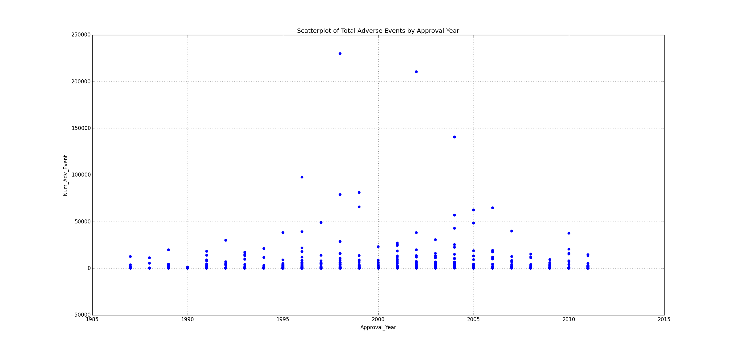
Adjusting Ordinal Inflated AE to 2004 AE
Notes:
I created an inflation index based upon “2004 AEs”

Slide 17
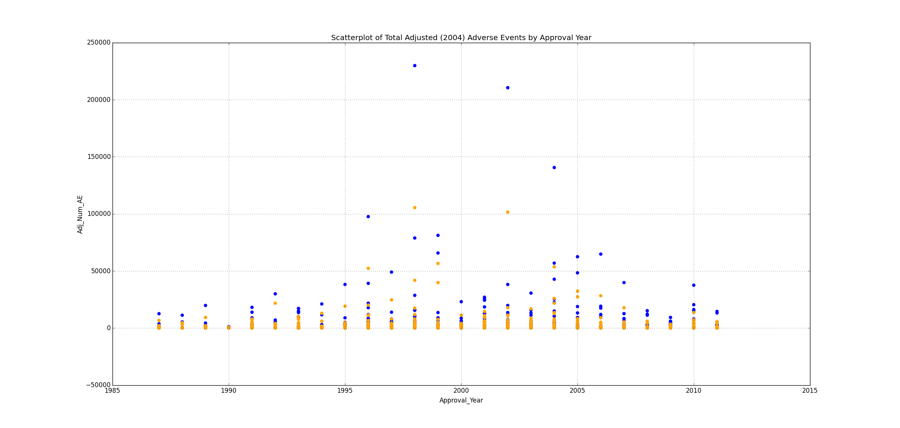
Adjusting Ordinal Inflated AE to 2004 AE

Slide 18
Issues with Inflation Adjustment
Still no utilization metric
Assumes insignificant inflator
Doesn’t get rid of “outliers”
Notes:
The resulting adjusted AE shrinked a few of my “outliers” and gave me nice adjustment for more recent years
Overall though the shape adjustment did not change the shape of my data overwhelmingly
Unfourtnutaely, I don’t know how drug utilization affects these numbers.

Slide 19
Addition to Class Makes up +46% of all Drugs in Lanthier et al. but only 32% Total AE

Slide 20
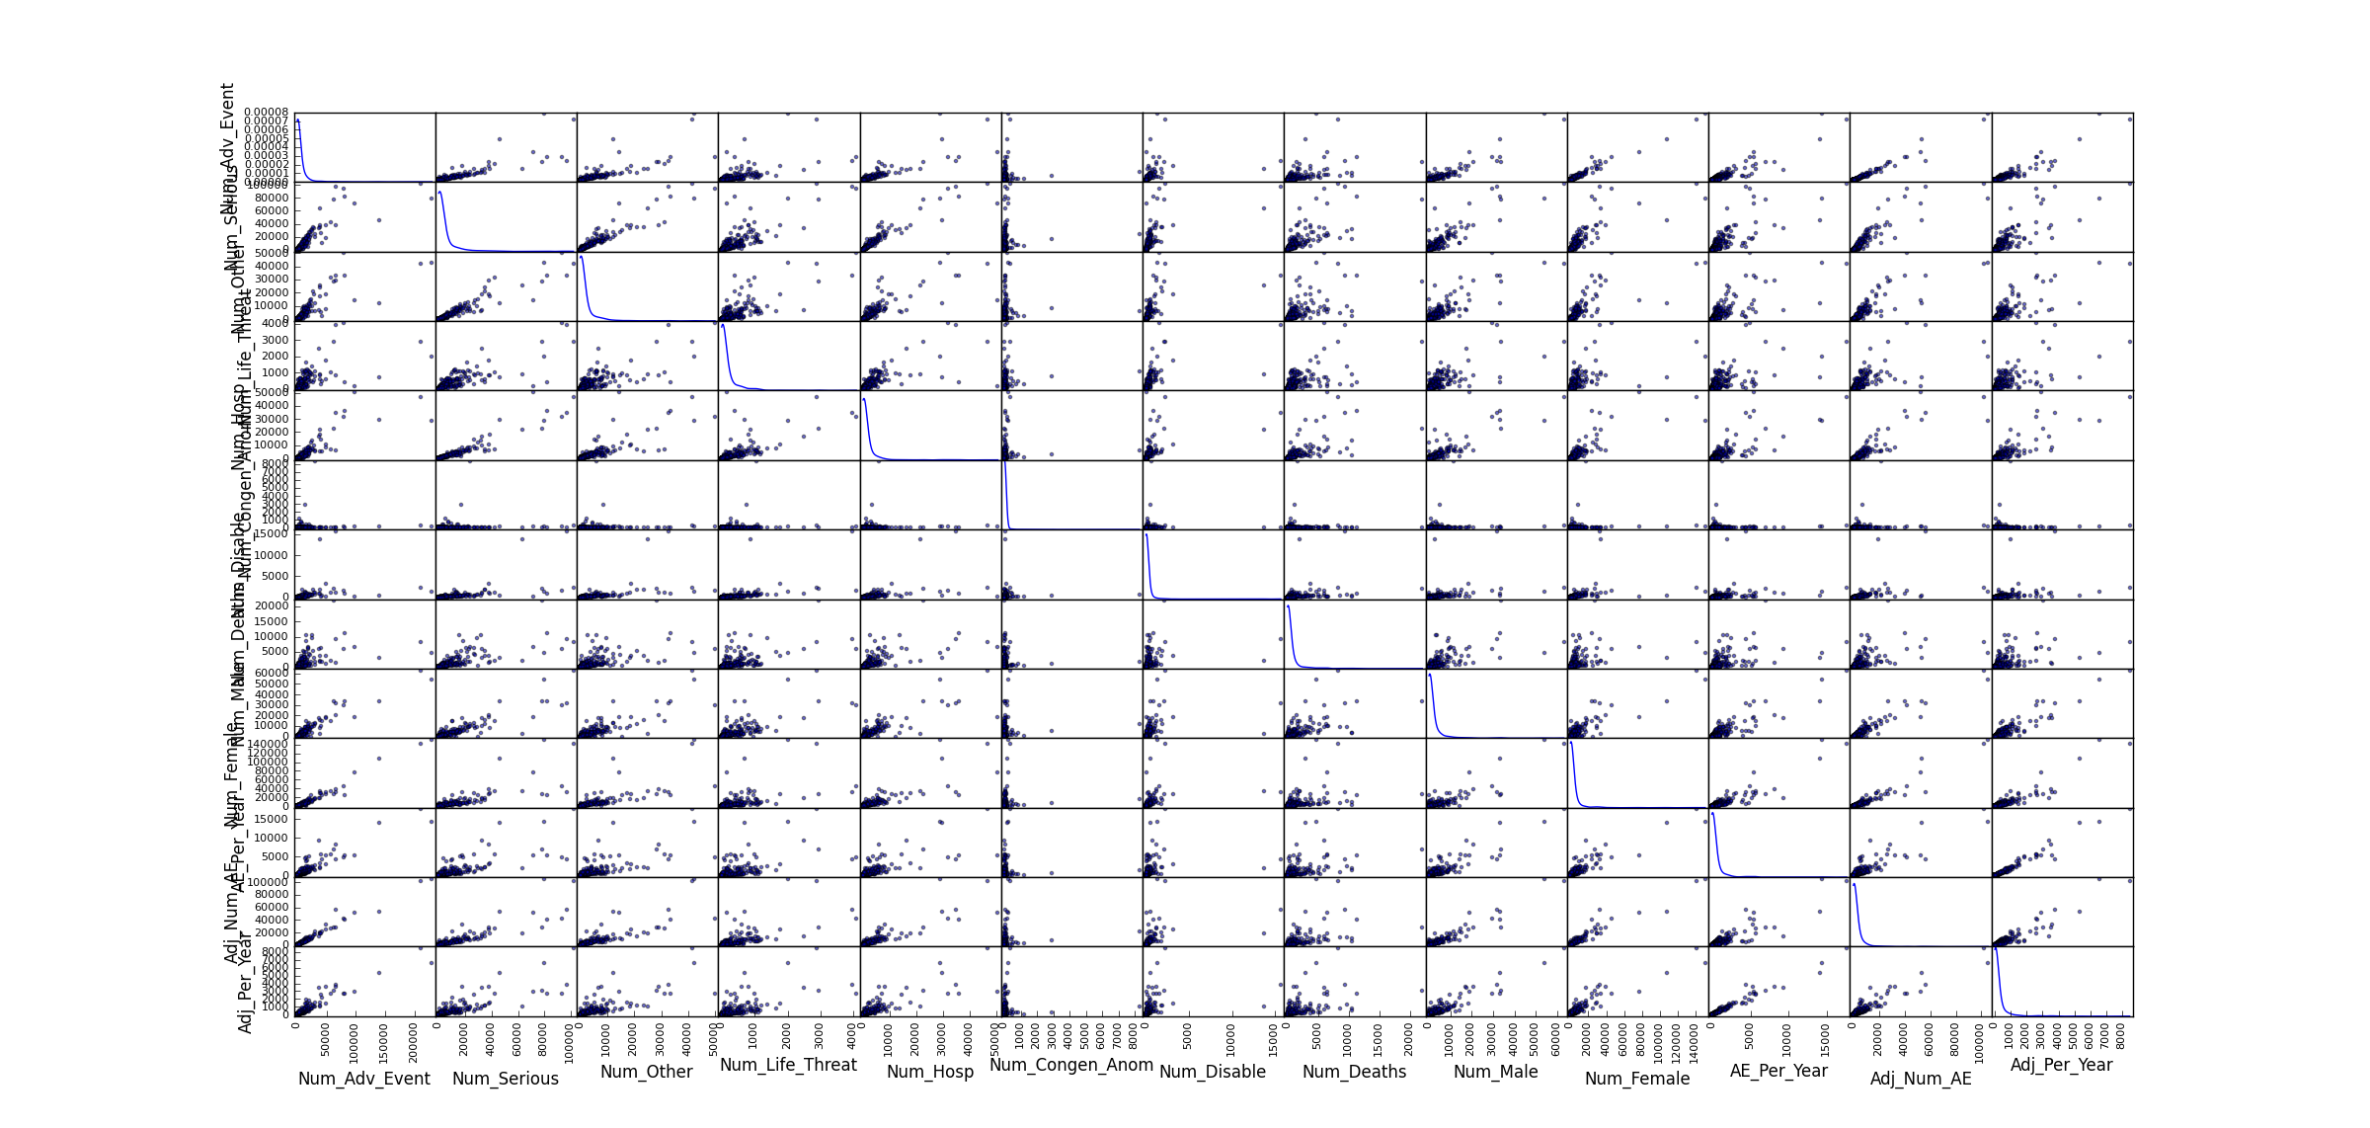
Power Laws and High Correlation Across Majority of Variables

Slide 21
Lomax Distribution
Support at x = 0, exponent = ~ 0.45
Exponent needs to be above 2 to calculate mean; above 3 to calculate variation
Black swan behavior
Notes:
I ran goodness-of-fir tests for a multitude of distributions for the total number of adverse events variable and settled on the Lomax distribution.

Slide 22
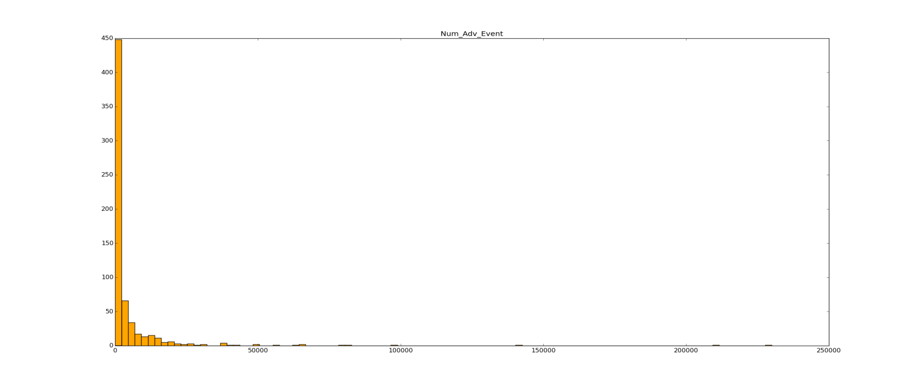
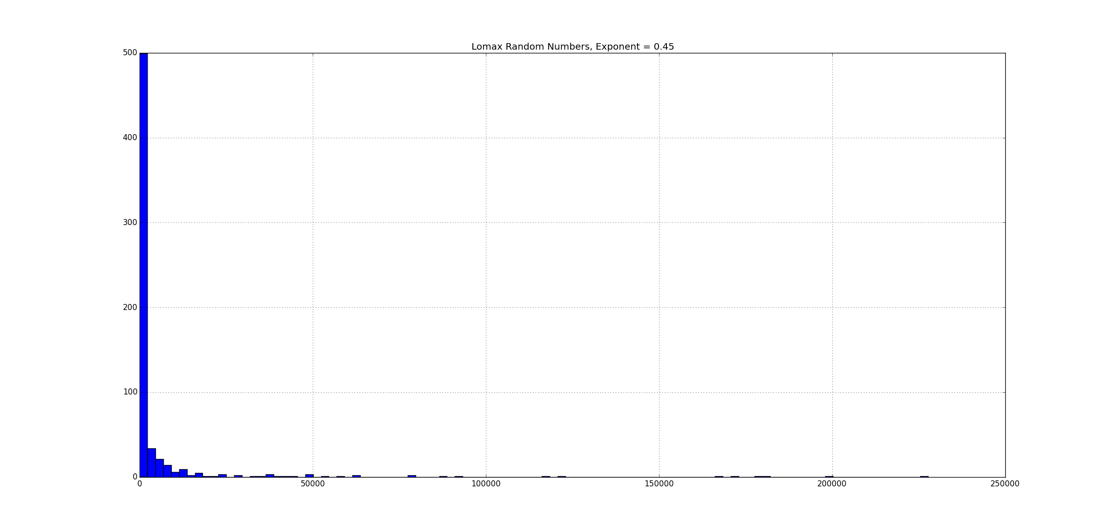
Lomax Distribution
Num_Adv_Event
Randomly Generated Lomax
Notes:
The distribution fit pretty well

Slide 23
AE Matrix Correlation
 | Approval_Year | Innovation_Cat | Num_Adv_Event | Num_Life_Threat | Num_Congen_Anom | Num_Disable | Num_Deaths | AE_Per_Year | Adj_Num_AE | Adj_Per_Year
Approval_Year | 1 | 0.075411005 | 0.081943979 | 0.075032531 | -0.066030691 | 0.001892237 | 0.100281884 | 0.206949757 | 0.066574952 | 0.185824366
FDA_Drug_Class
Innovation_Cat | 0.08 | 1.00 | 0.05 | 0.07 | -0.04 | 0.02 | 0.11 | 0.06 | 0.05 | 0.06
Num_Adv_Event | 0.08 | 0.05 | 1.00 | 0.67 | 0.12 | 0.37 | 0.57 | 0.93 | 0.98 | 0.95
Norm_Adv_Event | 0.08 | 0.05 | 1.00 | 0.67 | 0.12 | 0.37 | 0.57 | 0.93 | 0.98 | 0.95
Num_Serious | 0.07 | 0.07 | 0.86 | 0.84 | 0.13 | 0.60 | 0.78 | 0.79 | 0.89 | 0.85
Num_Other | 0.07 | 0.06 | 0.83 | 0.80 | 0.10 | 0.54 | 0.66 | 0.76 | 0.86 | 0.81
Num_Life_Threat | 0.08 | 0.07 | 0.67 | 1.00 | 0.16 | 0.57 | 0.68 | 0.66 | 0.72 | 0.71
Num_Hosp | 0.07 | 0.05 | 0.87 | 0.74 | 0.10 | 0.51 | 0.70 | 0.80 | 0.89 | 0.84
Num_Congen_Anom | -0.07 | -0.04 | 0.12 | 0.16 | 1.00 | 0.05 | 0.05 | 0.07 | 0.16 | 0.09
Num_Disable | 0.00 | 0.02 | 0.37 | 0.57 | 0.05 | 1.00 | 0.36 | 0.31 | 0.45 | 0.39
Num_Deaths | 0.10 | 0.11 | 0.57 | 0.68 | 0.05 | 0.36 | 1.00 | 0.57 | 0.59 | 0.60
Num_Male | 0.10 | 0.05 | 0.95 | 0.77 | 0.13 | 0.41 | 0.69 | 0.90 | 0.95 | 0.93
Num_Female | 0.07 | 0.04 | 0.98 | 0.60 | 0.11 | 0.34 | 0.47 | 0.91 | 0.96 | 0.92
AE_Per_Year | 0.21 | 0.06 | 0.93 | 0.66 | 0.07 | 0.31 | 0.57 | 1.00 | 0.89 | 0.98
Adj_Num_AE | 0.07 | 0.05 | 0.98 | 0.72 | 0.16 | 0.45 | 0.59 | 0.89 | 1.00 | 0.94
Adj_Per_Year | 0.19 | 0.06 | 0.95 | 0.71 | 0.09 | 0.39 | 0.60 | 0.98 | 0.94 | 1.00
Notes:
Even though data is not normally distributed, which is strongly suggested when doing a persona correlation coefficient calculation, I did it anyway.
I determined Num_Life_Threat, Num_Congen_Anom, Num_Disable, Num_Deaths were good candidates

Slide 24
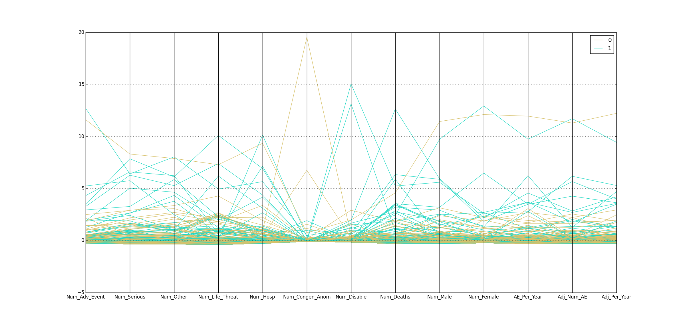
Parallel Coordinates

Slide 25
Parallel Coordinates
Notes:
Parallel coordinated threw a bit of a wrench into things
Confirmed, Life_Threat, Serious, and Deaths, but also cast doubt on Congen and Disable

Slide 26
Top Predictors
Total Number of Adverse Events - Num_Adv_Event
Total Number of Congenital Anomalies -Num_Congen
Total Number of Deaths - Num_Deaths
Total Number of Disabilities – Num_Disable
Notes:
I ended up consolidating to these four predictors

Slide 27
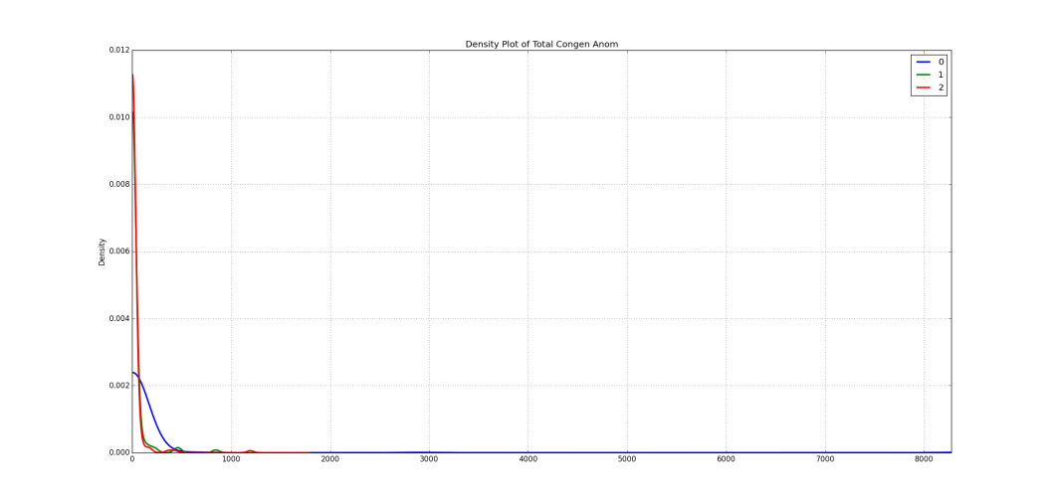
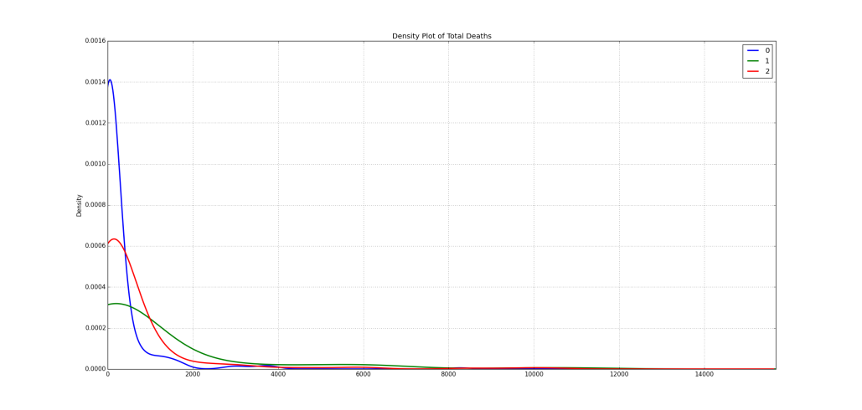
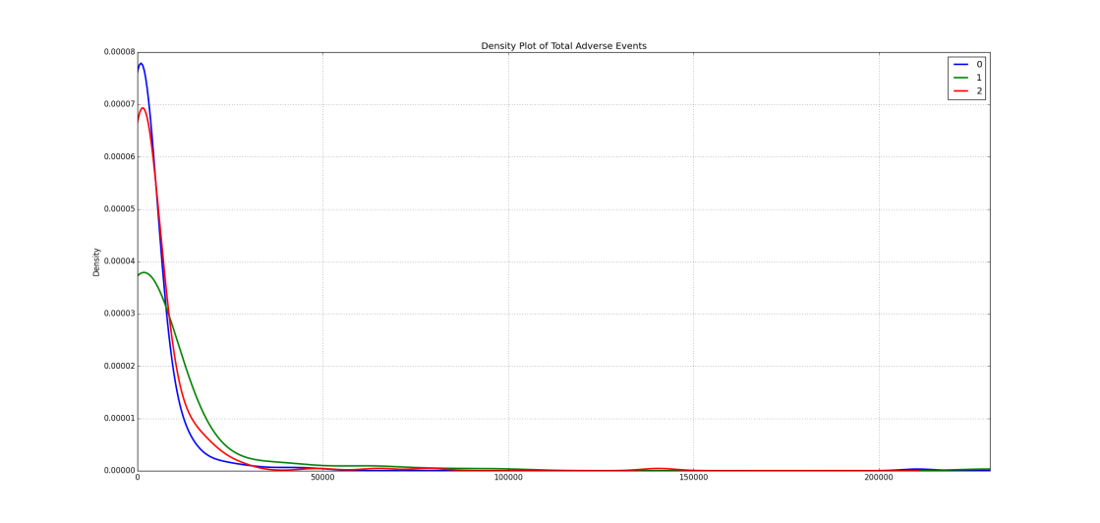
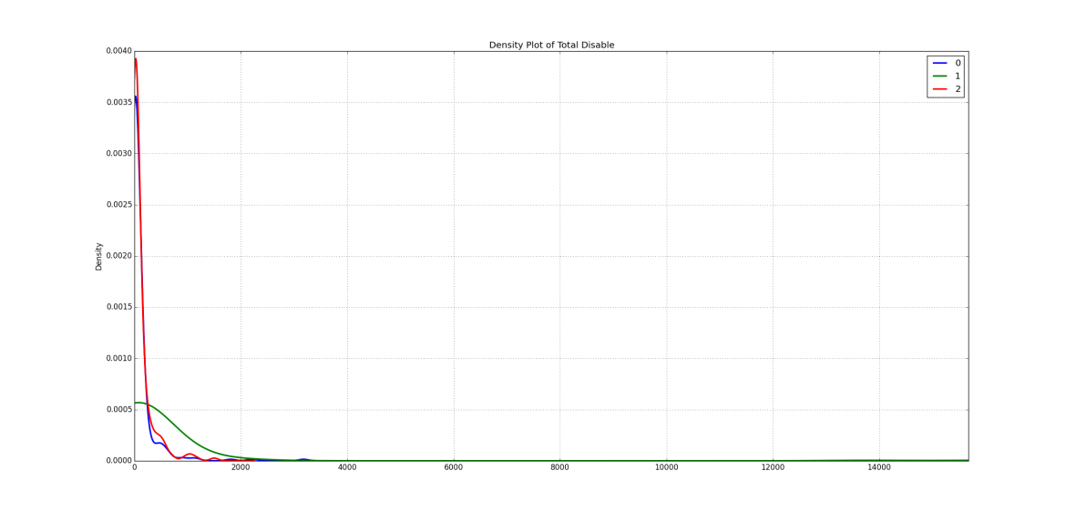
Power Law Holds But Advanced-in-Class Has Fatter Tails
Congen_Anom
Deaths
Num_Adv_Event
Disable

Slide 28
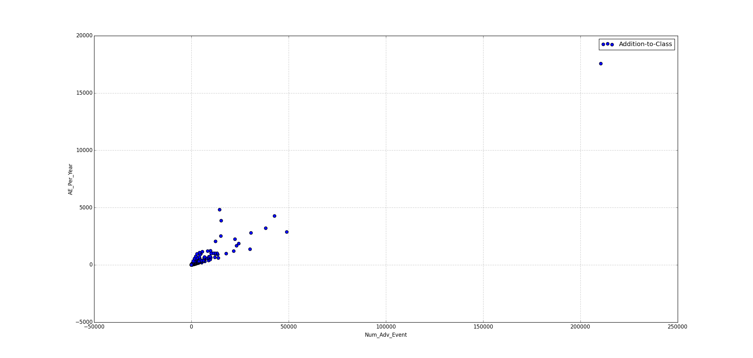
How Close are the Addition-to-Class and Advanced-in-Class classes?
Num_Adv_Event

Slide 29
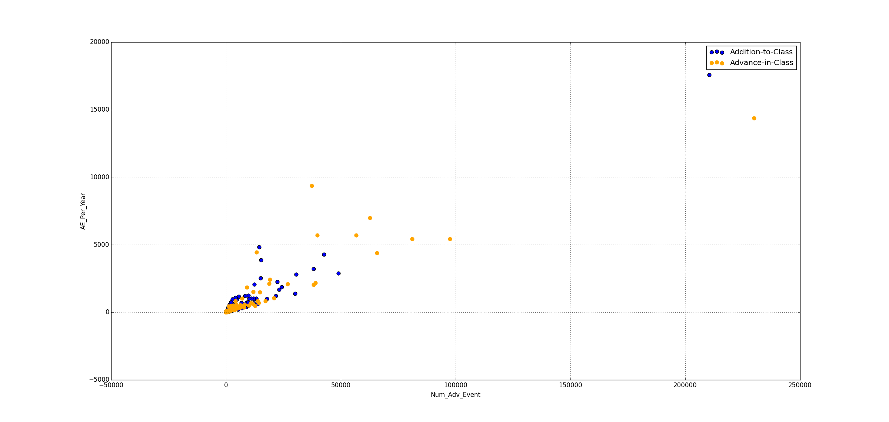
How Close are the Addition-to-Class and Advanced-in-Class classes?
Num_Adv_Event

Slide 30
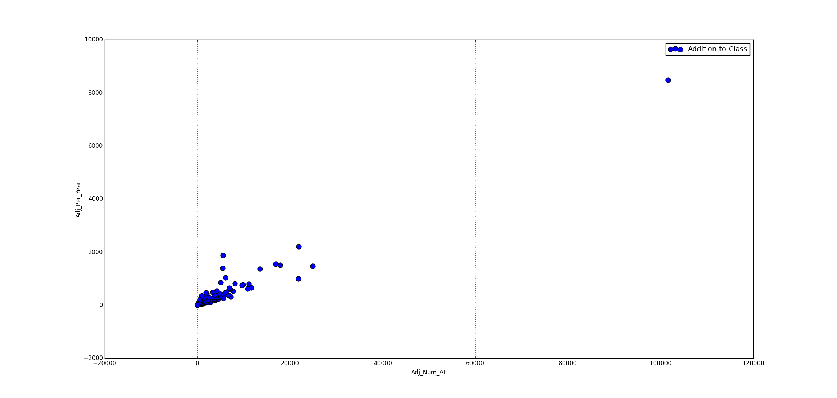
How Close are the Addition-to-Class and Advanced-in-Class classes?
Adj_Num_AE

Slide 31
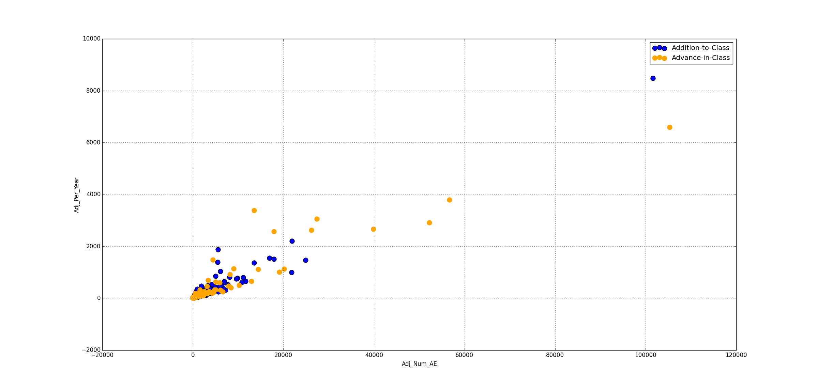
How Close are the Addition-to-Class and Advanced-in-Class classes?
Adj_Num_AE

Slide 32
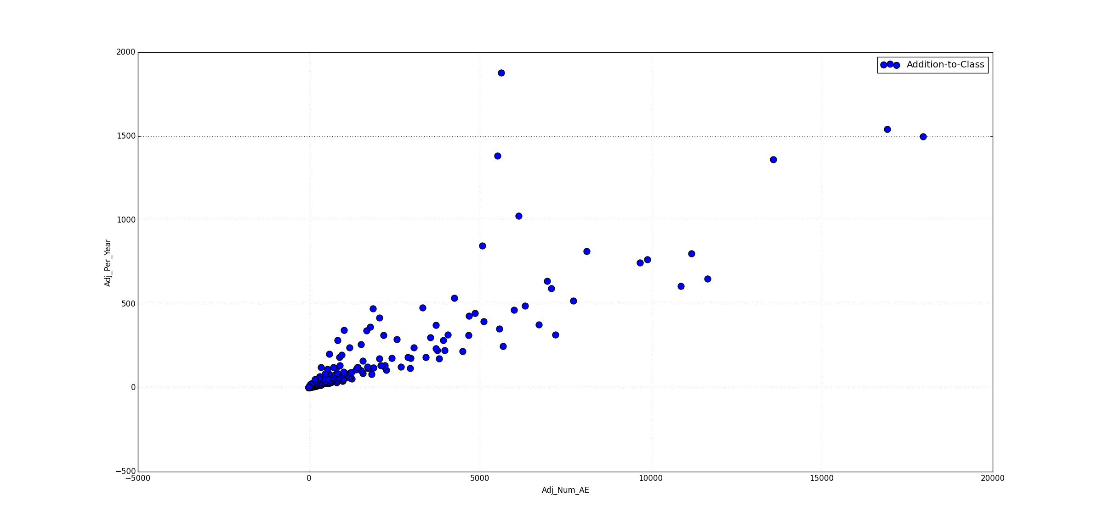
Truncated Data (Adj_Num_AE < 20,000)

Slide 33
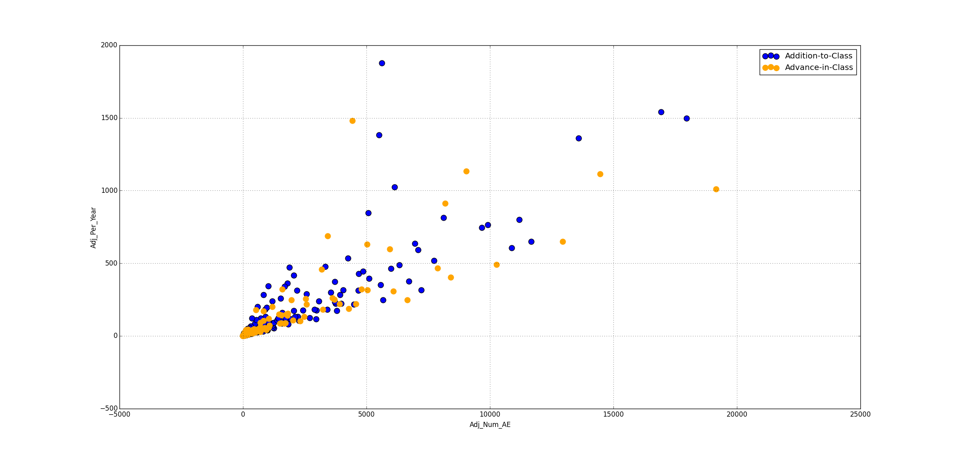
Truncated Data (Adj_Num_AE < 20,000)

Slide 34
Logistic Regression Model
Built individual models for top 4 predictors( Num_Adv_Event, Num_Disable, Num_Deaths, Num_Congen_Anom)
Built a comprehensive model with all predictors
Used recursive feature elimination to find optimal model (Num_Adv_Event, Num_Life_Threat, Num_Deaths, Num_Male, Num_Female, Adj_Per_Year)

Slide 35
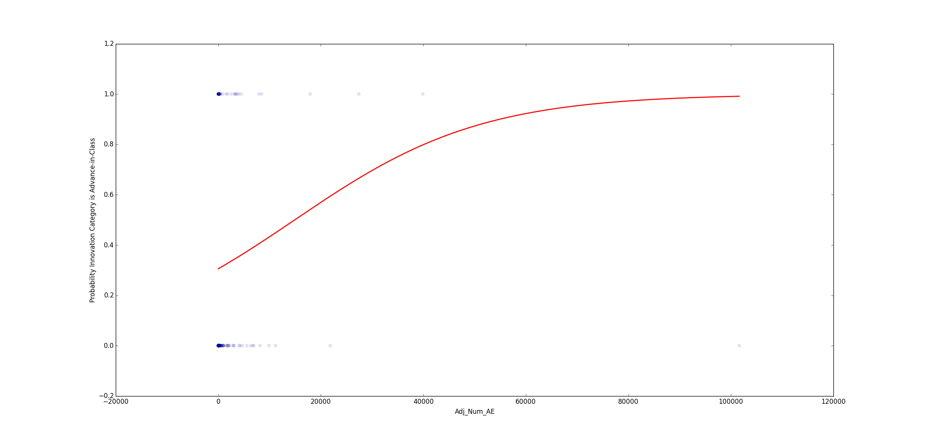
Num_Adv_Event/Adj_Num_AE

Slide 36
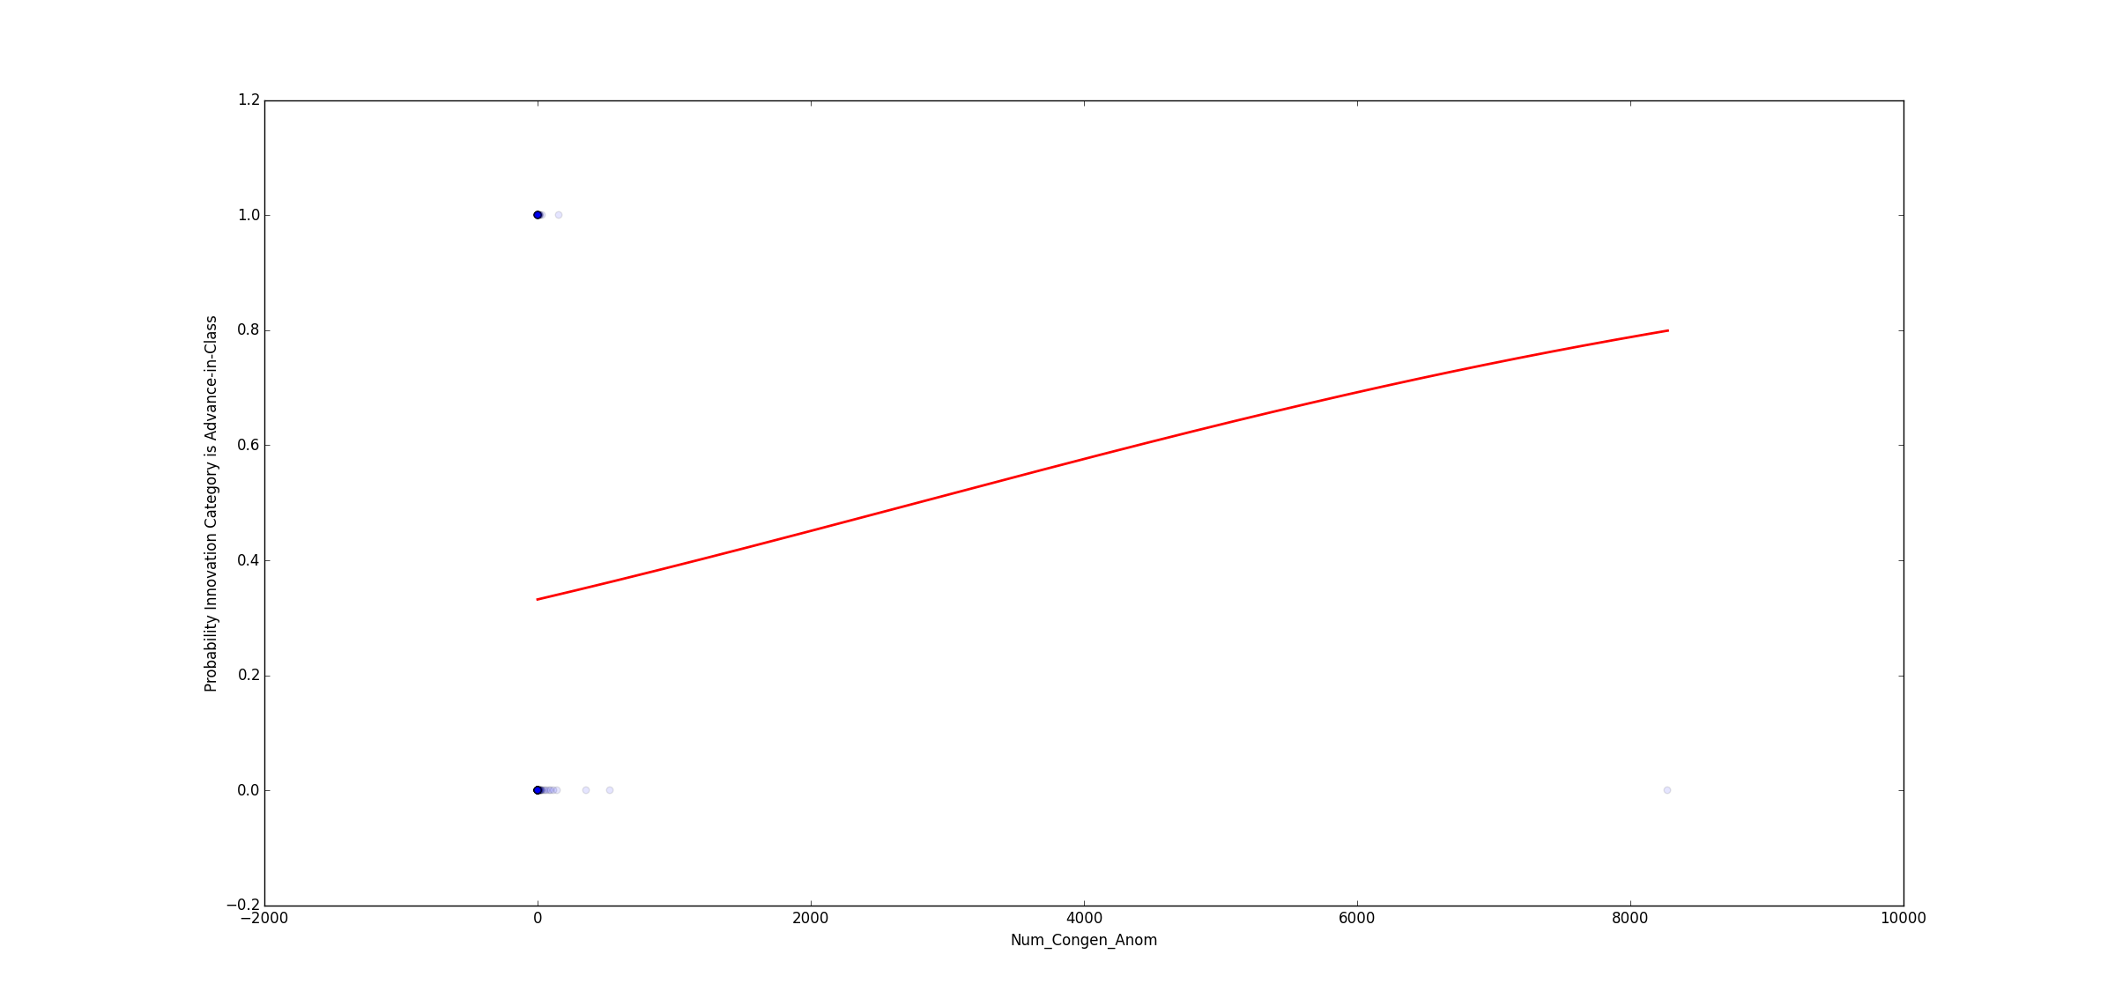
Num_Congen_Anom

Slide 37
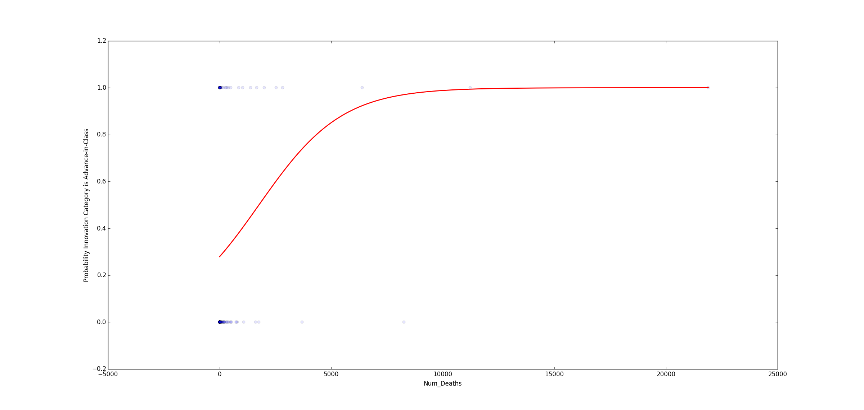
Num_Deaths

Slide 38
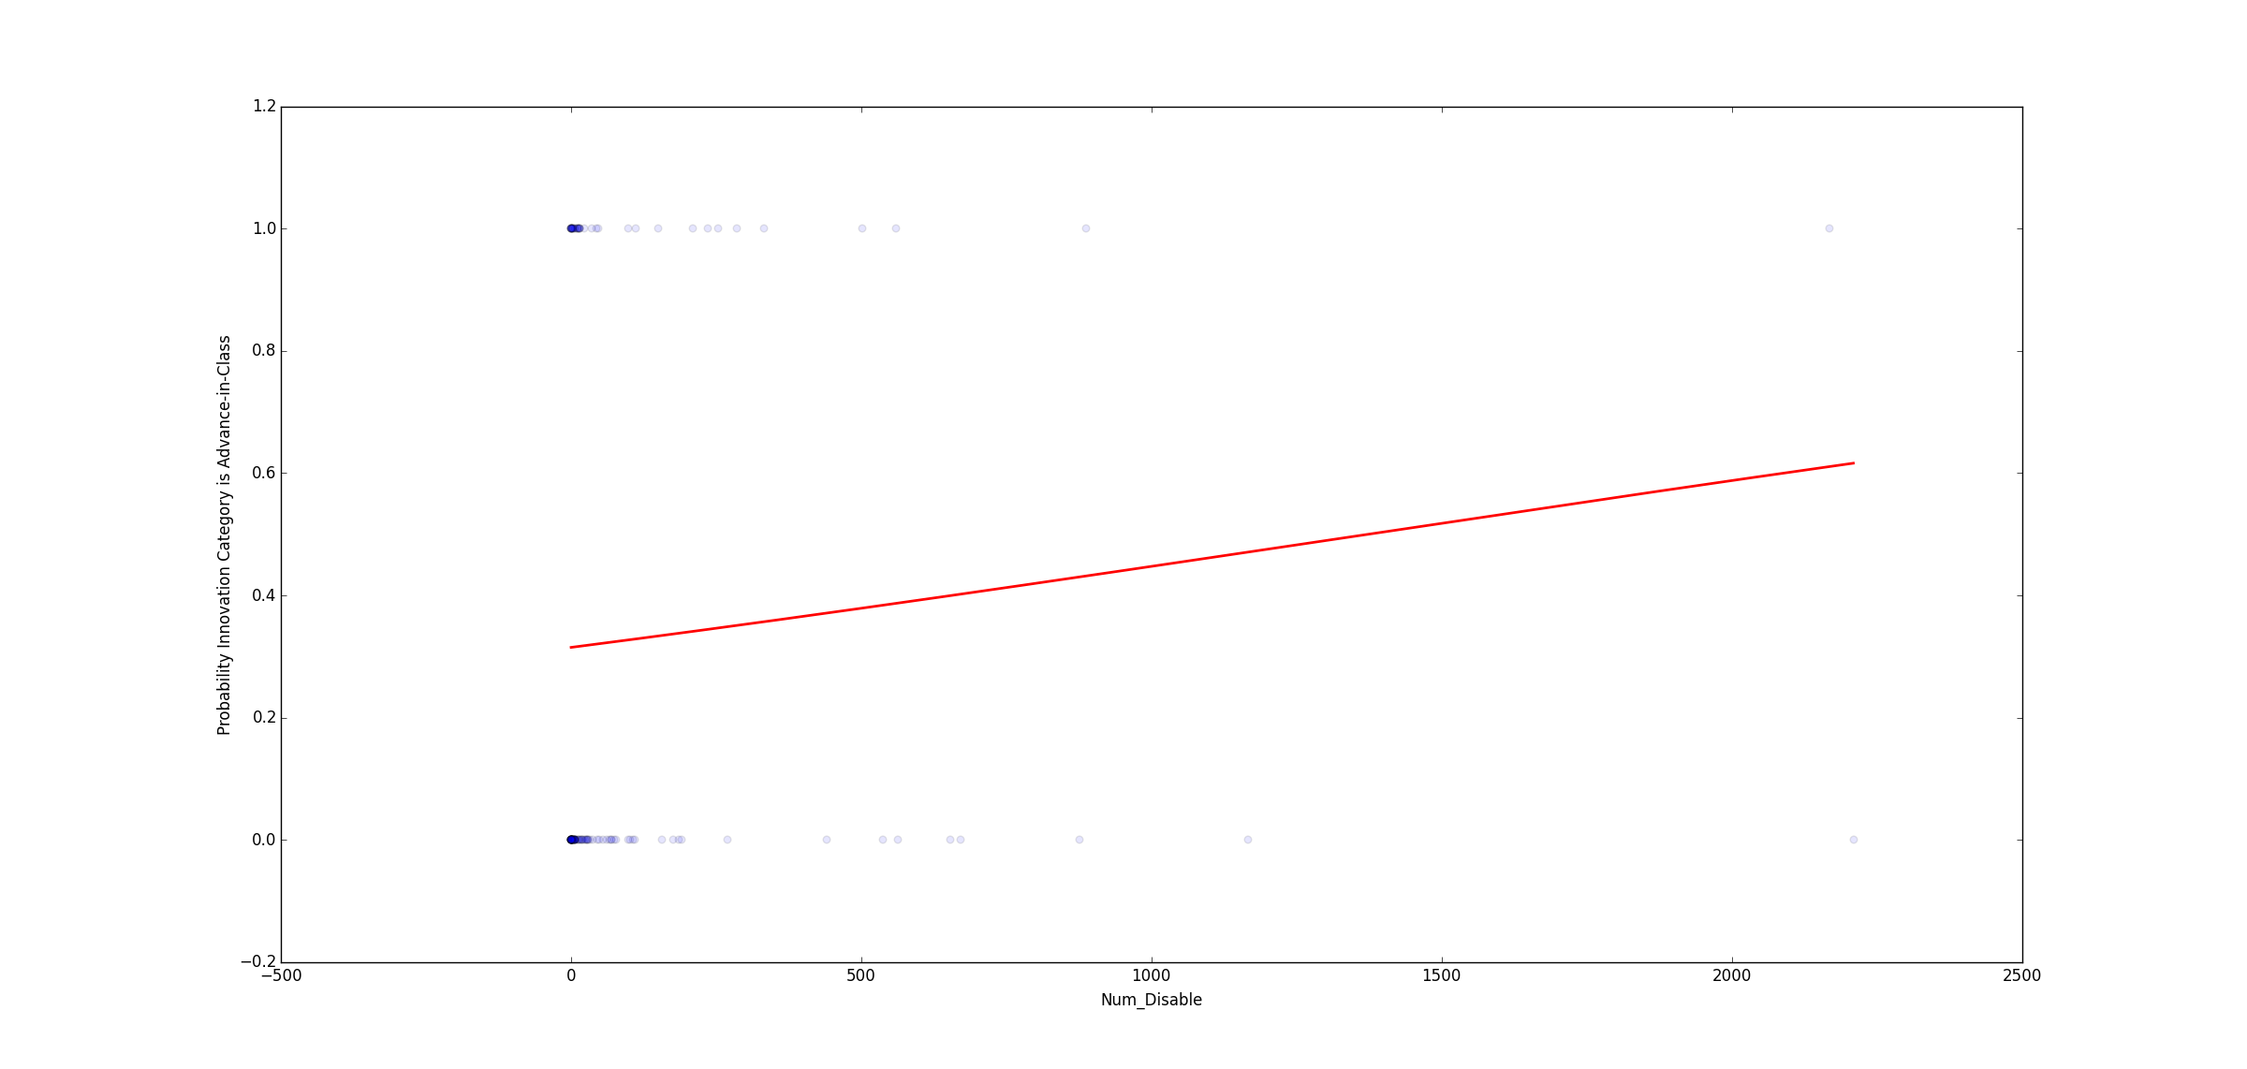
Num_Disable

Slide 39
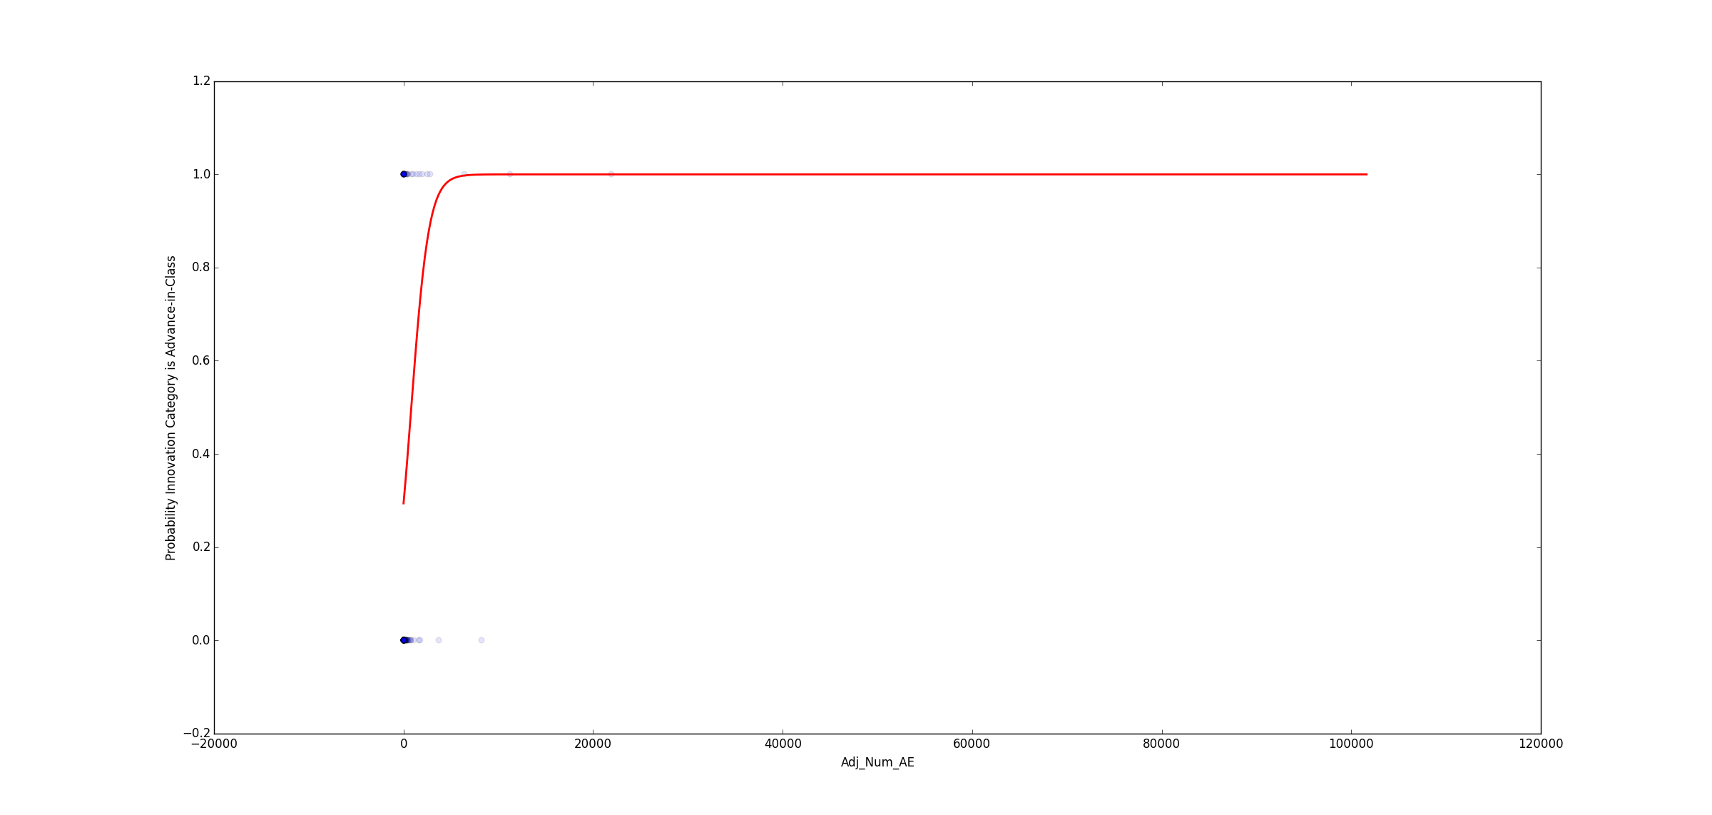
Comprehensive

Slide 40
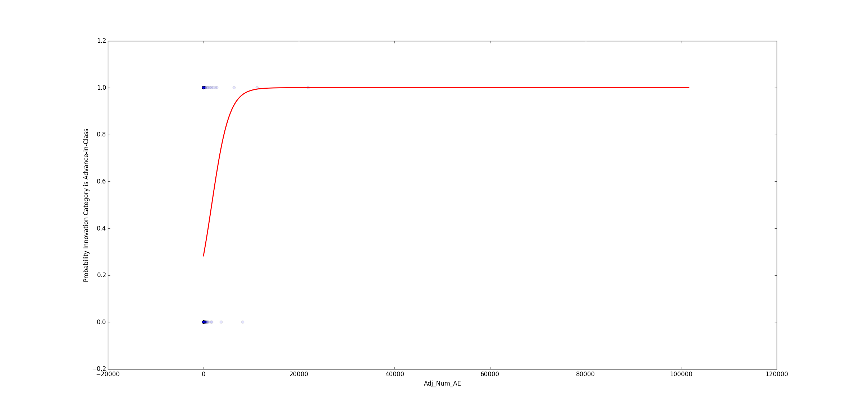
Optimal

Slide 41
Model Performance
Null: 67%
Optimum/Comprehensive
Accuracy : 73%
Specificity: 97.8%
Sensitivity: 19.5%
Best Individual Predictor (Num_Adv_Event)
Accuracy: 69%
Specificity: 97.8%
Sensitivity: 7%

Slide 42
Conclusion
Advanced-in-Class are correlated with higher adverse events in general
More Advanced-in-Class are located in the fat tails than Addition-to-Class
Possibly because since they are “better” therapies more people use them and this more AE
Model had poor sensitivity but showed decent responsiveness at the tails

Slide 43

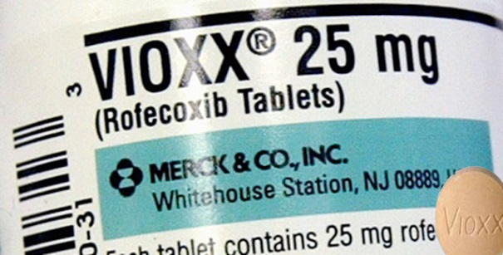


Prime Suspects
Remicade
Vioxx (Removed from market)
Humira (It is the world's top-selling drug)
Revlimid

